Slide 1
‘An Efficient Novel Approach for Detection of Fuel Monitoring System through IoT Sensors for a Sustainable Environment’
Published in
ICMPC 2023, E3S Web of Conferences(2023)

Slide 2

Submitted to
Dr. Sajeeb Saha
(Associate Professor)
Department of Computer Science & Engineering
Jagannath University
Presented By
Homayra ID: M240205013
Jerin Tesnim ID: M240205005
Israt Jahan Swarna ID: M240205035
Department of Computer Science & Engineering
Jagannath University
Future Internet and IoT
CSE5201

Slide 3
Contents
INTRODUCTION
PREVIOUS STUDY
PROPOSED DESIGN
RESULTS AND ANALYSIS
CONCLUSIONS
FUTURE ENHANCEMENTS

Slide 4
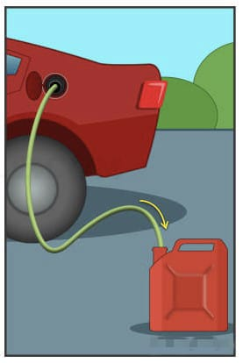
INTRODUCTION
Siphoning
Common methods of fuel theft include:
Siphoning: Manually removing fuel from a tank using a hose or other device.
Fraudulent transactions: Fake receipts, inflated fuel consumption reports, or using one fuel card to fill multiple vehicles.
Physical theft: Stealing entire fuel tanks or siphoning fuel from vehicles or storage tanks.

Slide 5

Consequences of fuel theft:
Financial losses: increased fuel prices and security expenses.
Operational disruptions: Disrupt schedules and operations
Increased security costs: cameras, or security personnel.
The black-market availability, creating unfair competition and compromising legitimate businesses
Fuel theft poses severe risks to public safety, which can lead to accidents, fires, and environmental damage.
INTRODUCTION

Slide 6
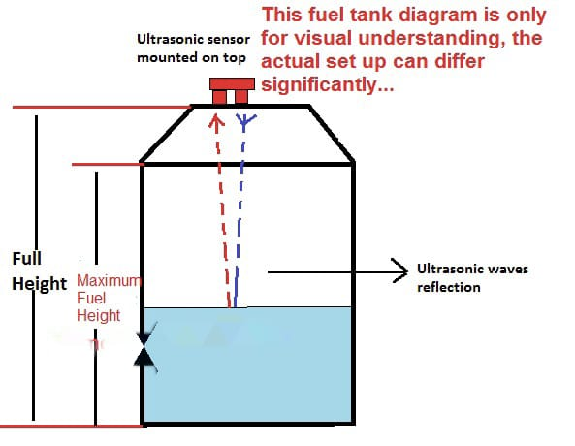
PREVIOUS STUDY
Ultrasonic sensor for fuel level detection: the sensor at the top of the fuel tank and converted to distance, which then corresponds to the fuel level.
Tools: Microcontroller, sensor data and display
Drawback: No real-time location, due to which we cannot track our module.

Slide 7
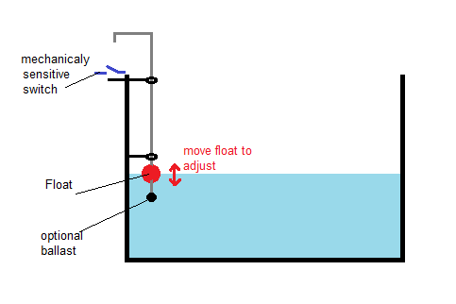
Raspberry Pi: ADC to convert the analogue signal to a digital one that the Pi can sending alerts or displaying the fuel level via a connected display or remotely via IoT.
Tools: ADC to convert, Sensor with Raspberry Pi and display
Drawback: the readings were not properly due to a shift in fuel surface and cannot be executed for lower quantities of fuel in the system.
PREVIOUS STUDY

Slide 8
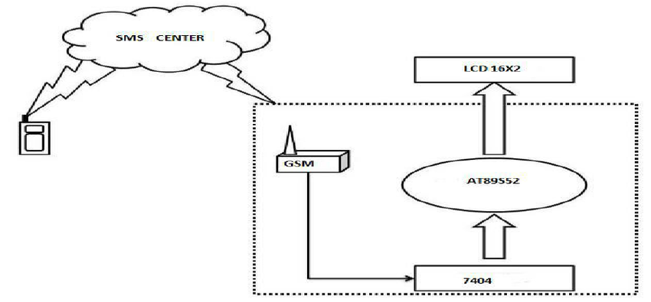
GSM-based fuel theft detection system: Uses a GSM modem to alert a vehicle owner via SMS when fuel theft is detected.
Tools: GSM modem, sensor, microcontroller
Drawback: Not providing a measure in case of any issues using the GSM infrastructure.
PREVIOUS STUDY

Slide 9
Jerin Tesnim ID: M240205005
Department of Computer Science & Engineering
Jagannath University

Slide 10
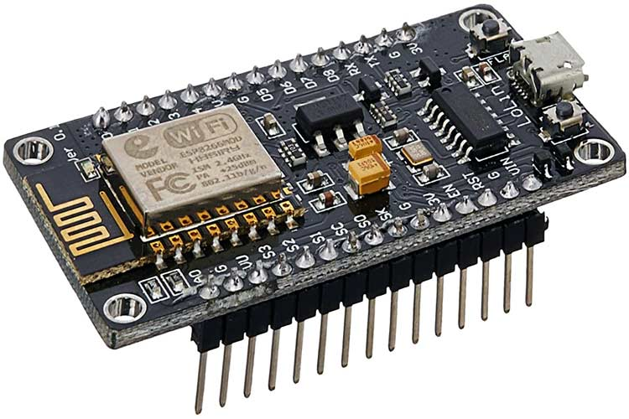
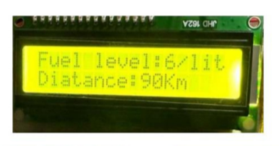
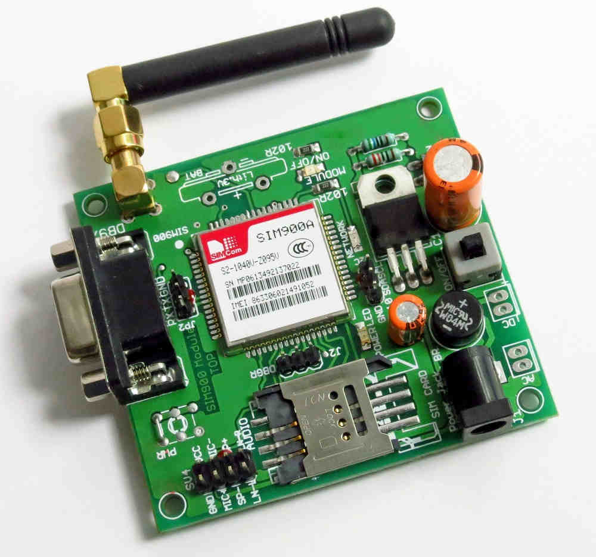
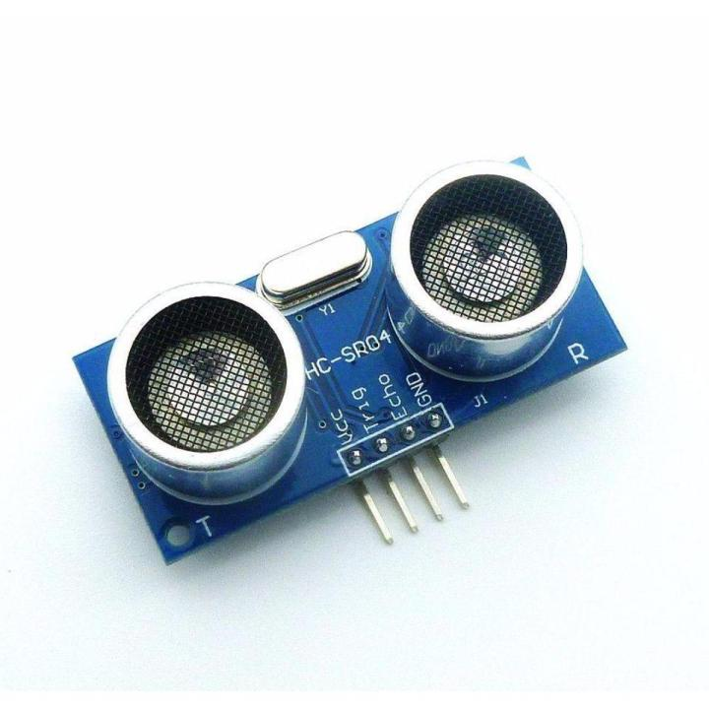
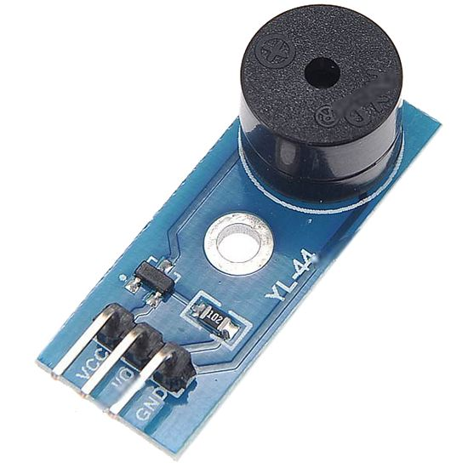
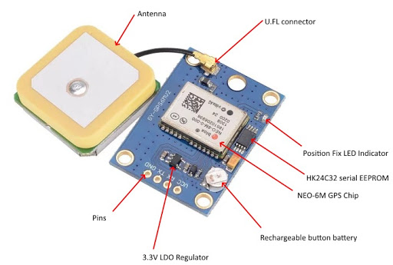
PROPOSED DESIGN
We are going to build a Fuel Theft Detection and Monitoring System that can check the fuel level and send the information online.
Wi-Fi + GSM → IOTA Network → ThingSpeak (Cloud)
LCD
Gismo VII(Esp8266)
GSM Module
Ultrasonic Sensor
Buzzer Sensor
GPS Module
A web-based dashboard will show the data live, so users can check fuel status anytime.

Slide 11
PROPOSED DESIGN
To detect if any fuel is being stolen and to keep track of fuel levels in real time using internet and mobile technology.
ThingSpeak is a cloud-based platform used in IoT to collect, store, analyze, and display data from sensors and devices.IoT developers and researchers use ThingSpeak to make smart apps, monitor data in real time, and make better decisions based on sensor data.
Wi-Fi + GSM → IOTA Network → ThingSpeak (Cloud)
LCD
Gismo VII(Esp8266)
ThingSpeak
GSM Module
Buzzer Sensor
GPS Module
Ultrasonic Sensor

Slide 12
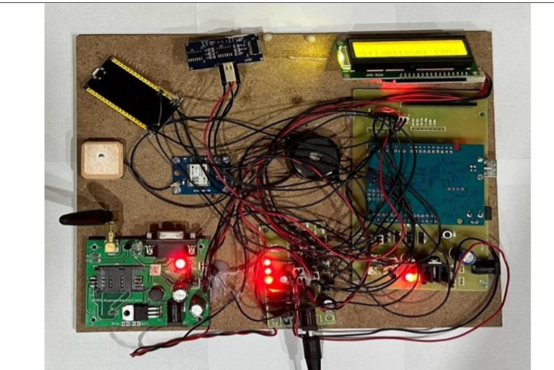
Hardware Prototype
Building an IoT circuit for a Fuel Theft Detection and Monitoring involves integrating various components to collect, process, and transmit fuel data.
Microcontroller : Acts as the system's brain such as Arduino, Raspberry Pi, or ESP32
Sensors : Use sensors like ultrasonic or float-level to measure fuel level and connect them to the microcontroller.
Power Supply : Provide stable power using batteries,
solar panels, or both.
Data Storage and Transmission : Store the data locally or send
it to the cloud using communication protocols.
Programming and Firmware : Write code (firmware) to read, process, and transmit data from sensors using suitable languages like C/C++ or MicroPython.

Slide 13
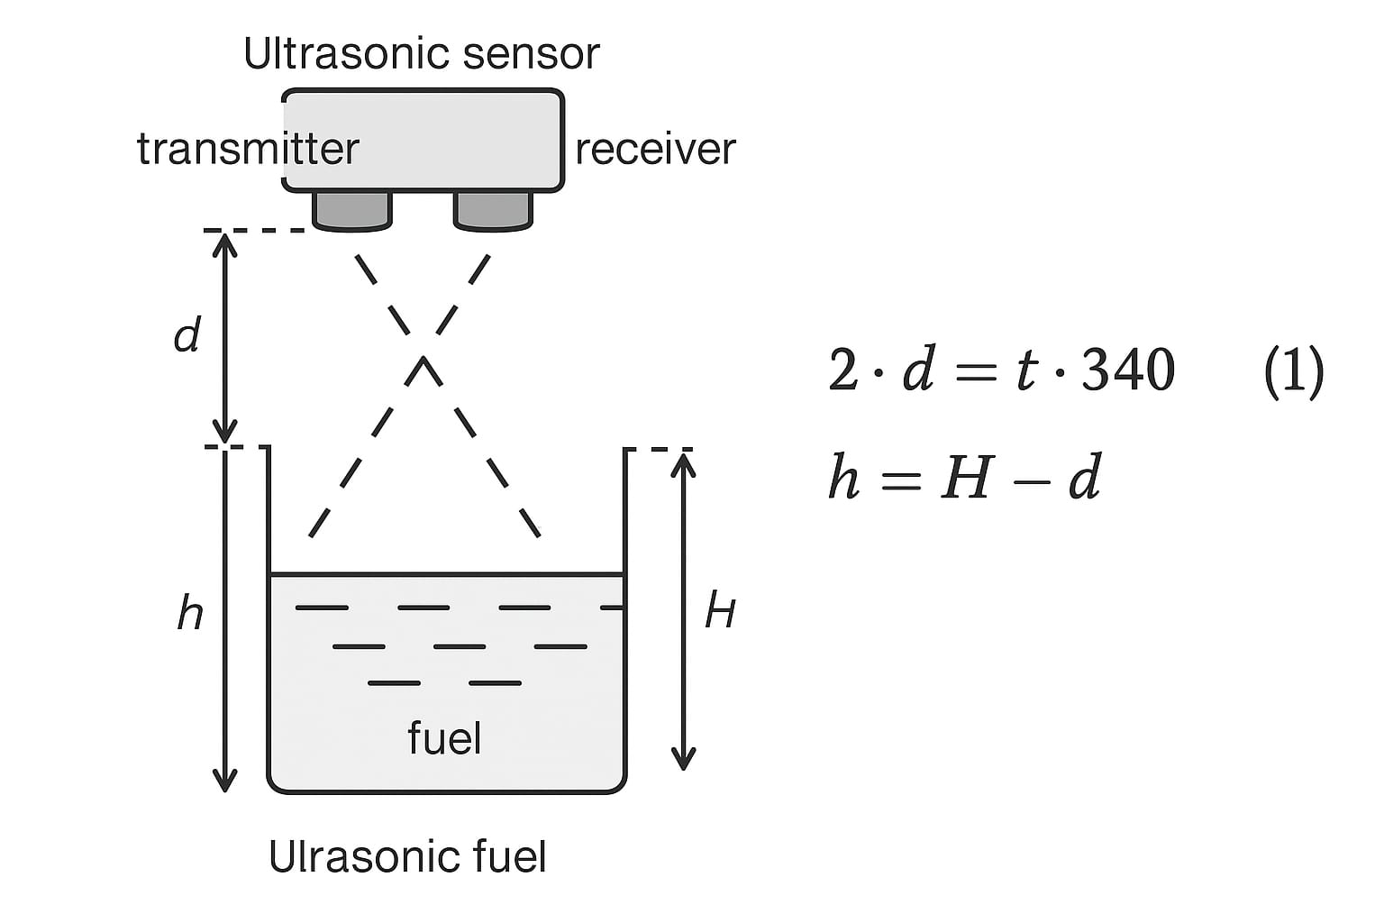
Stepwise Procedure
The proposed system follows the following step to complete the tasks:
Step 1: Ultrasonic Sensor collect Fuel data by measuring fuel level and
transforming the data into fuel capacity, Assuming the total travel
distance is 2d and time taken is t, using the formula:
2*𝑑 = 𝑡 ∗ 340 [The speed of ultrasonic wave in air is 340 m/s]
Fuel Height Calculation: Let H be the distance from the sensor to the tank bottom.
Then fuel level
h = H - d.
The value of ‘h’ is continuously monitored.
Detecting Fuel Theft: Measure fuel level at two times h₁ at t₁, and h₂ at t₂. Calculate rate of change: r = (h₁ − h₂) / (t₁ − t₂)
If the 'r' value surpasses this threshold, an alarm will activate, accompanied by the transmission of a message. This message will be facilitated through a micro-controller connected to a GSM modem.

Slide 14
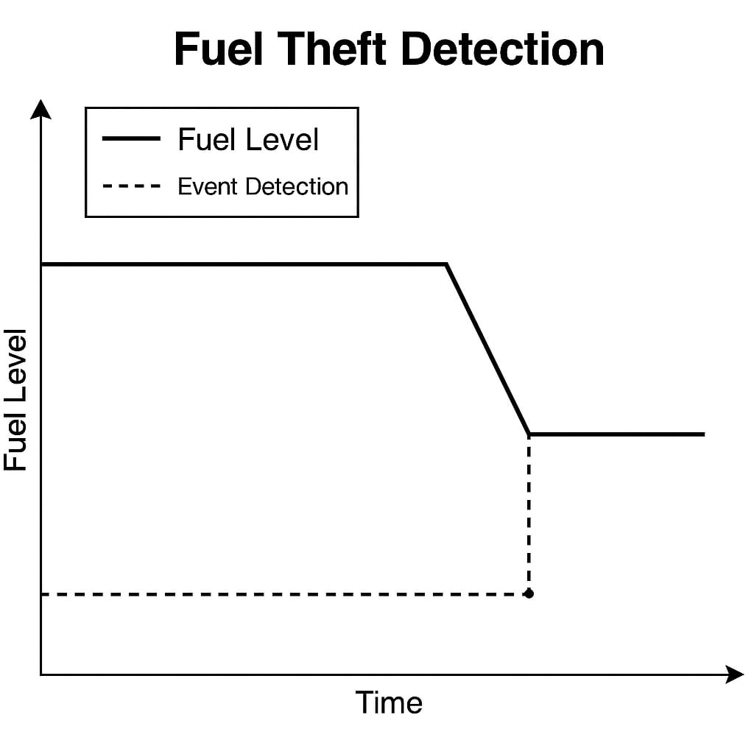
Stepwise Procedure
Step 2: The ESP32 module processes the data and prepares it for transmission.
Step 3: The ESP32 sends the processed data to Thing speak, the cloud-based platform.
Step 4: Thing speak stores and organizes the data for easy access.
Step 5: Users visualize and analyse the data through Thing speak's user-friendly interface.

Slide 15

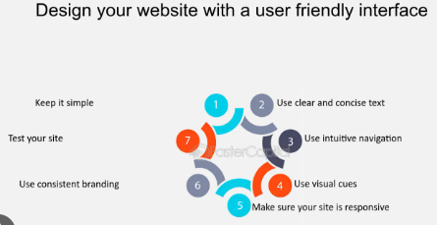

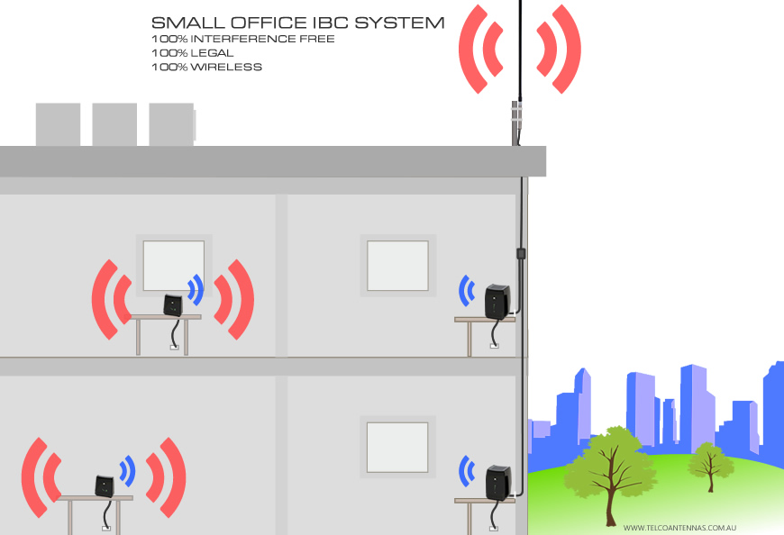
The system has some features that make the system unique.
The full system is cost-effective, with reasonably priced components, making it accessible to a wide range of users.
The model comes with an intuitive and user-friendly interface, ensuring that even non-technical users can quickly grasp.
Fast
The System exhibits a rapid response time, providing real-time fuel
data and updates promptly.
Wide Coverage Area
Since the system uses internet and SMS network, it can cover a large area. allowing users to access information remotely from various locations.

Slide 16


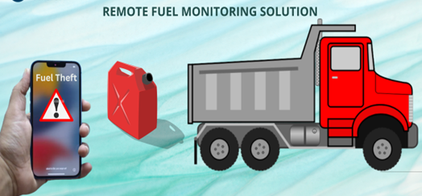
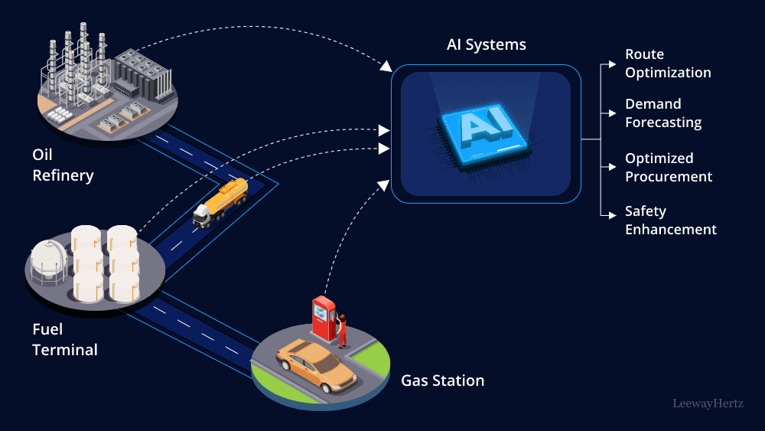
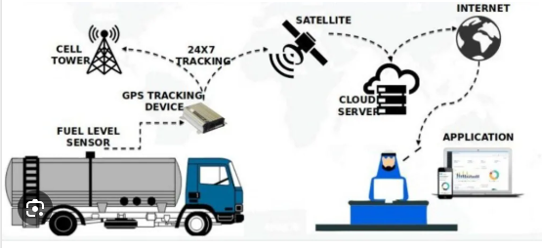
Applications
The applications where this proposed system used are:
Transportation Industry
Remote Location Monitoring
Logistics and Supply Chain
Rental Equipment Management
&
Public Transportation
Fuel Stations

Slide 17
Israt Jahan Swarna ID: M240205035
Department of Computer Science & Engineering
Jagannath University

Slide 18

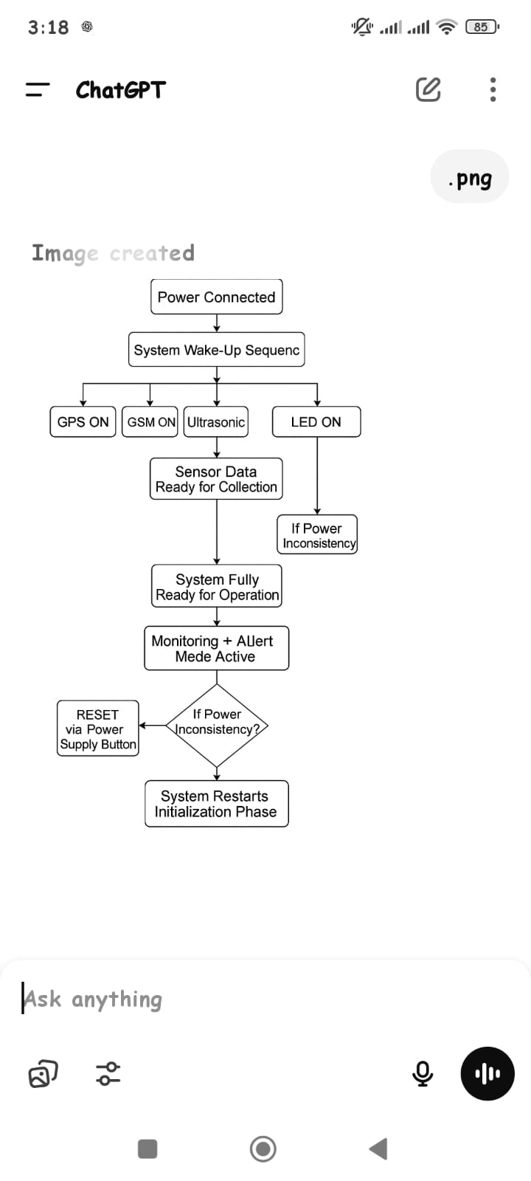
RESULTS AND ANALYSIS

Slide 19
Advantages of our System

Slide 20
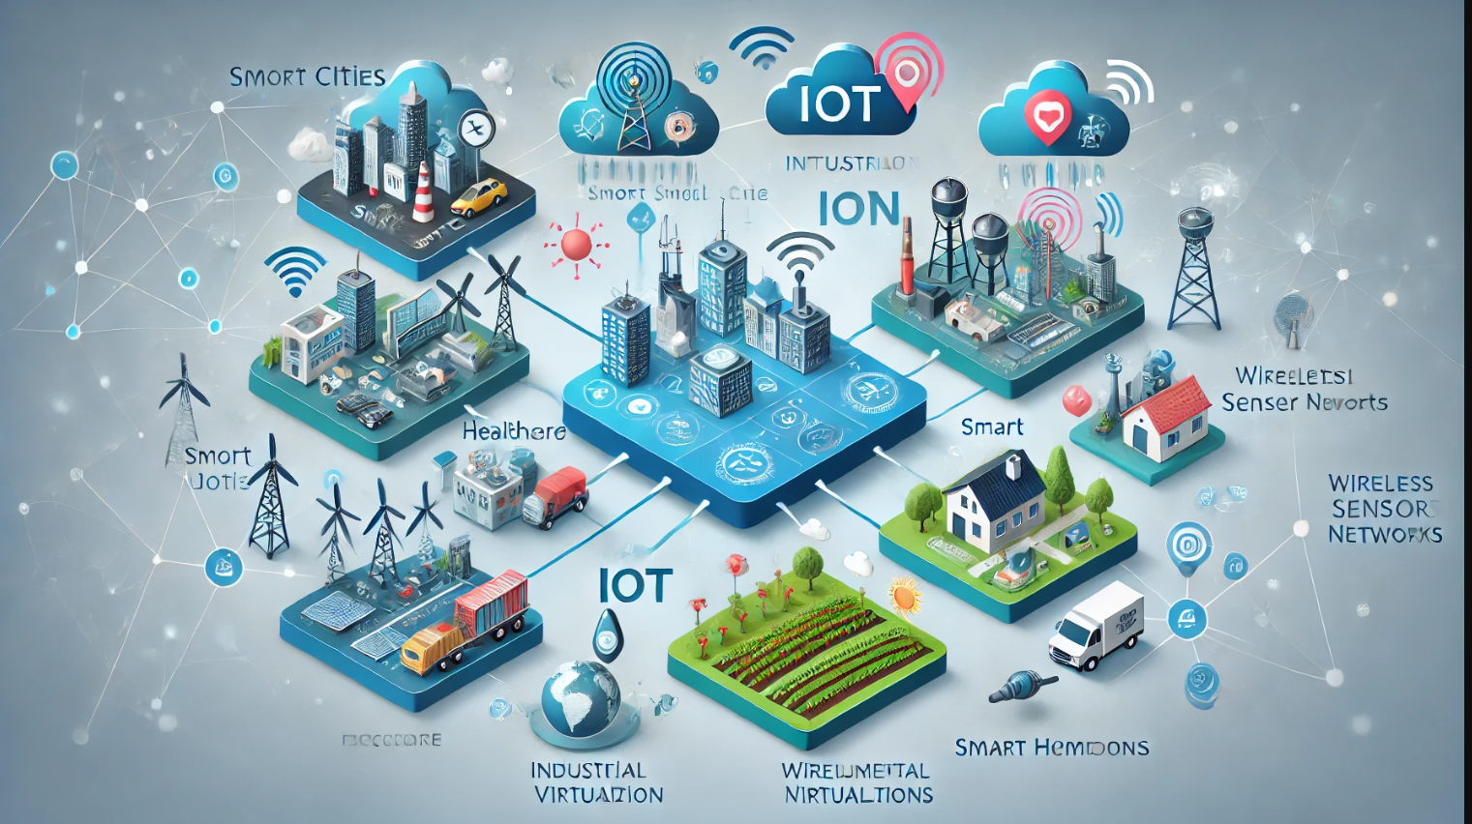

CONCLUSIONS

Slide 21
FUTURE ENHANCEMENTS

Slide 23
Any questions?...

Slide 24
Thank You..

